Slide 1
Moving Sale
Furniture Available (July 24-July 31)

Slide 2
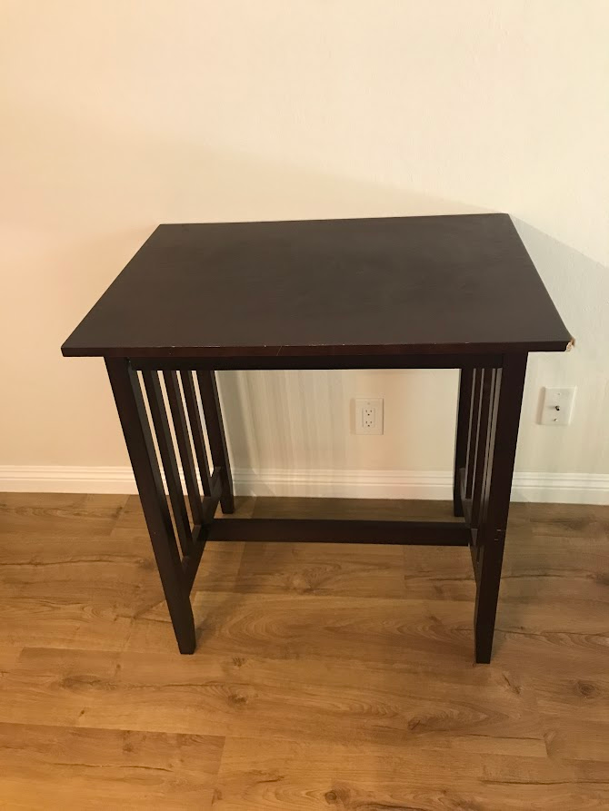
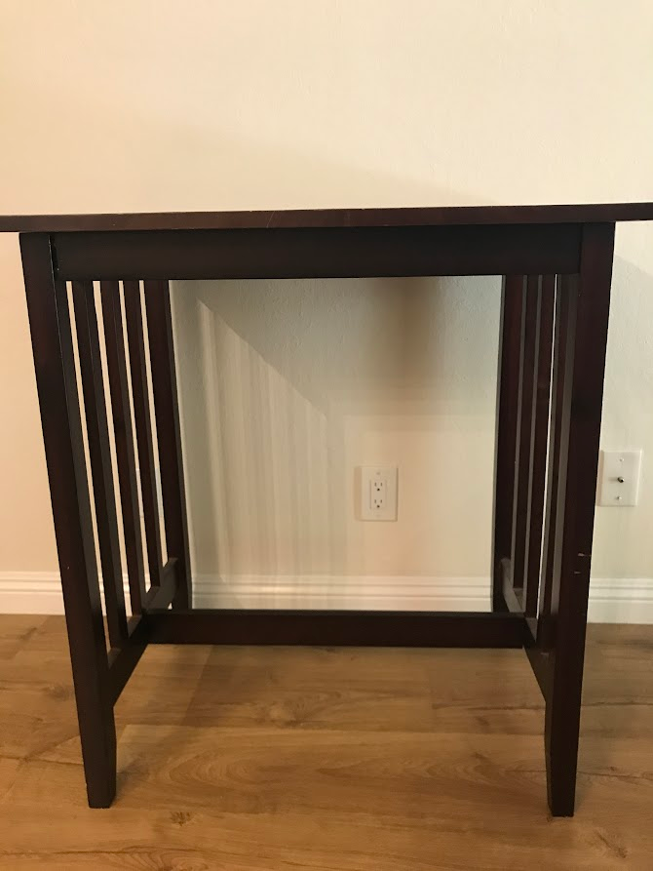
Tall Table: $10
Table has chip on the corner

Slide 3
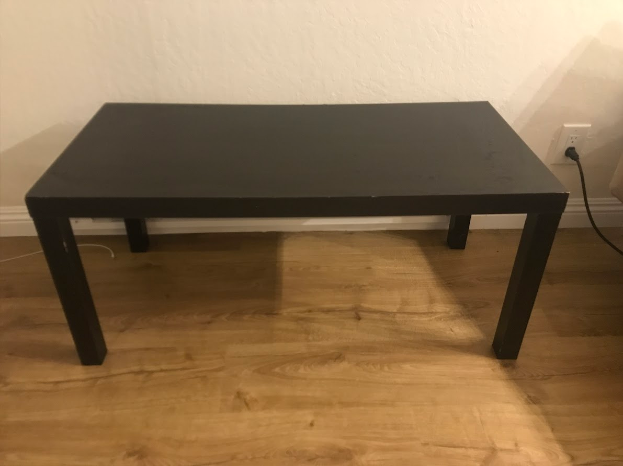
Coffee Table: $5

Slide 4
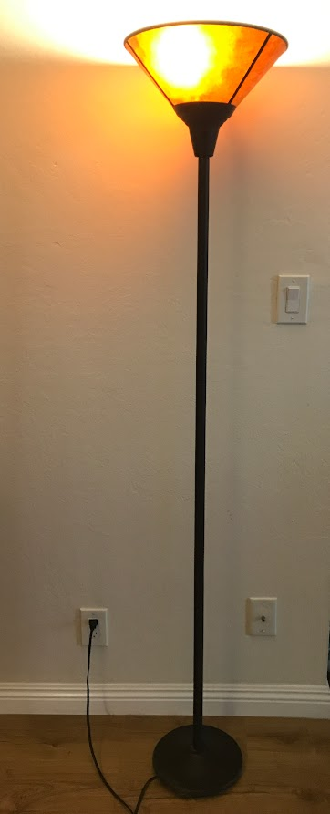
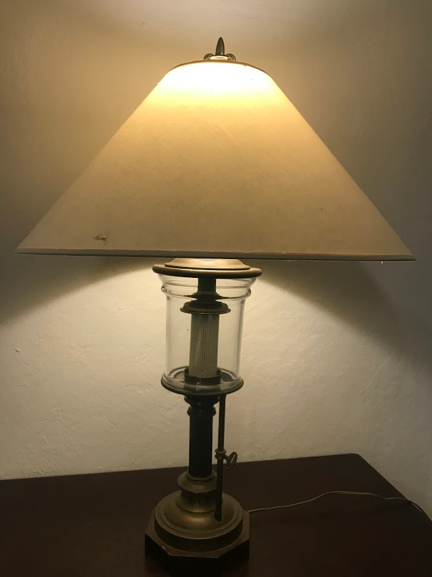
Desk Lamp: $10
Floor Lamp: $10

Slide 5
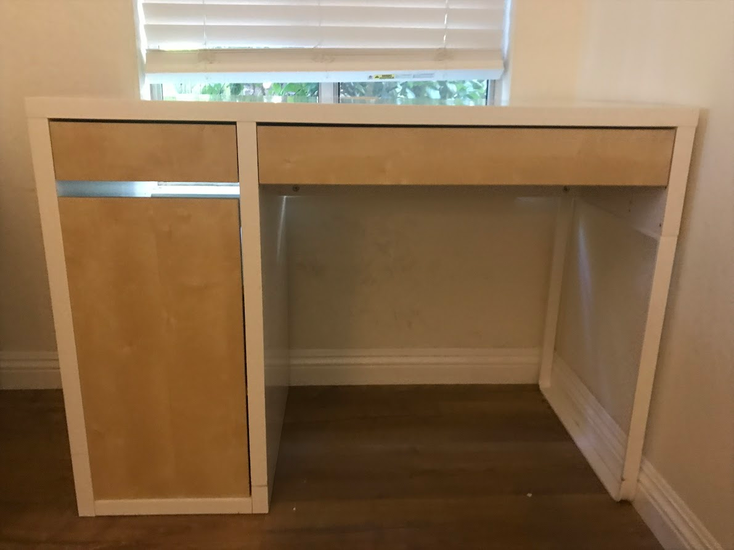
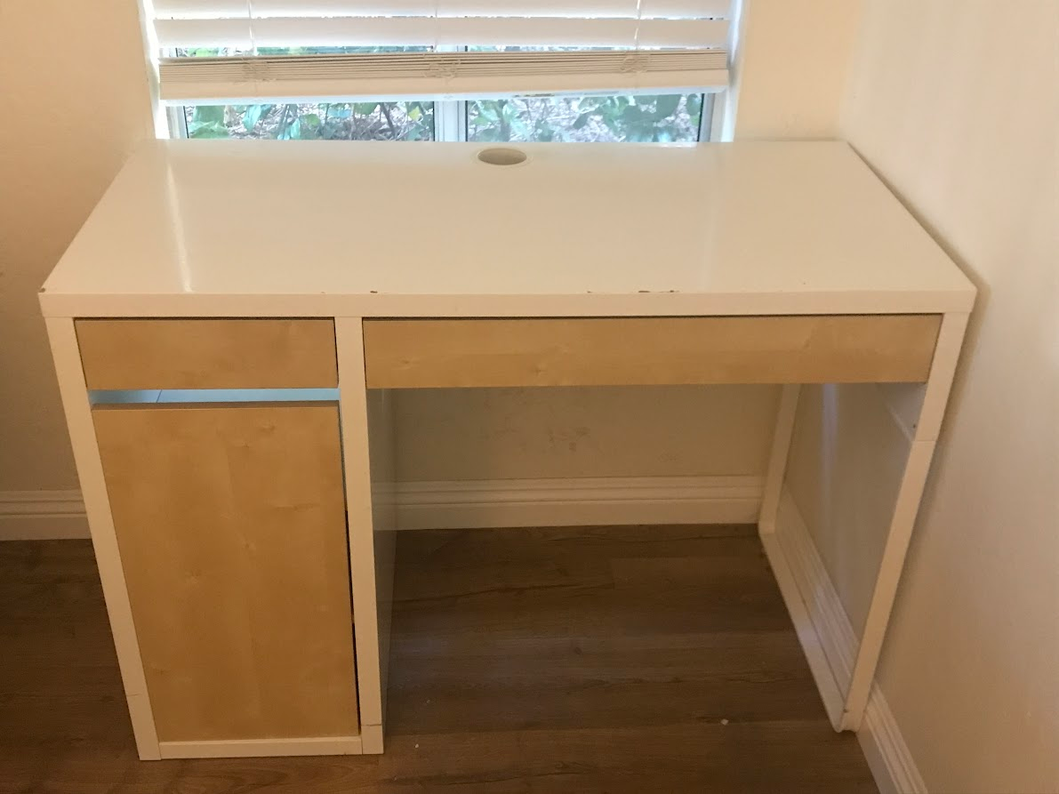
IKEA Desk: $20

Slide 6
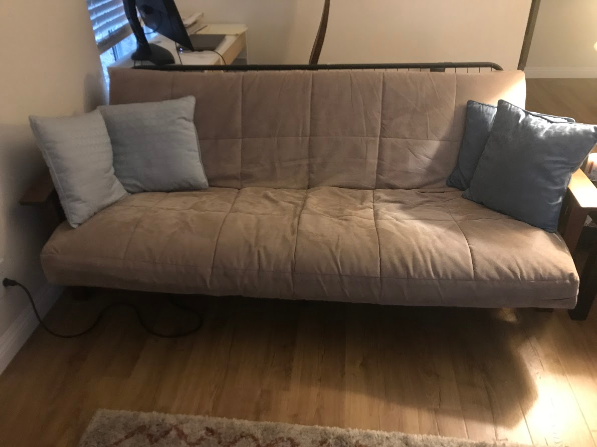
Futon + Pillows $20

Slide 7
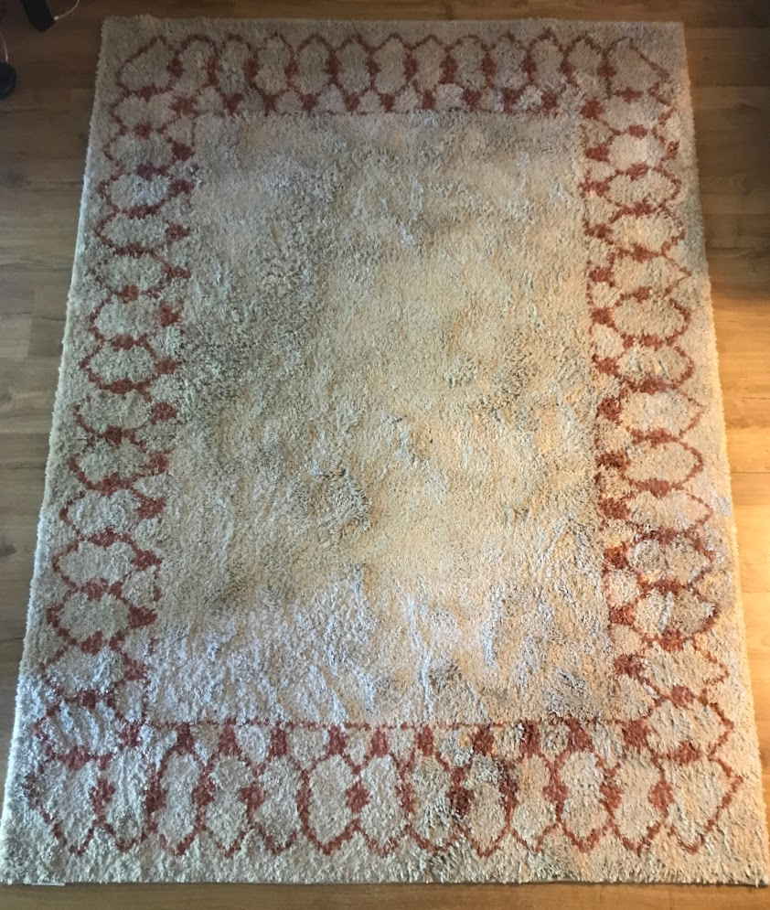
Floor Rug: $20
7ft x 5ft

Slide 8
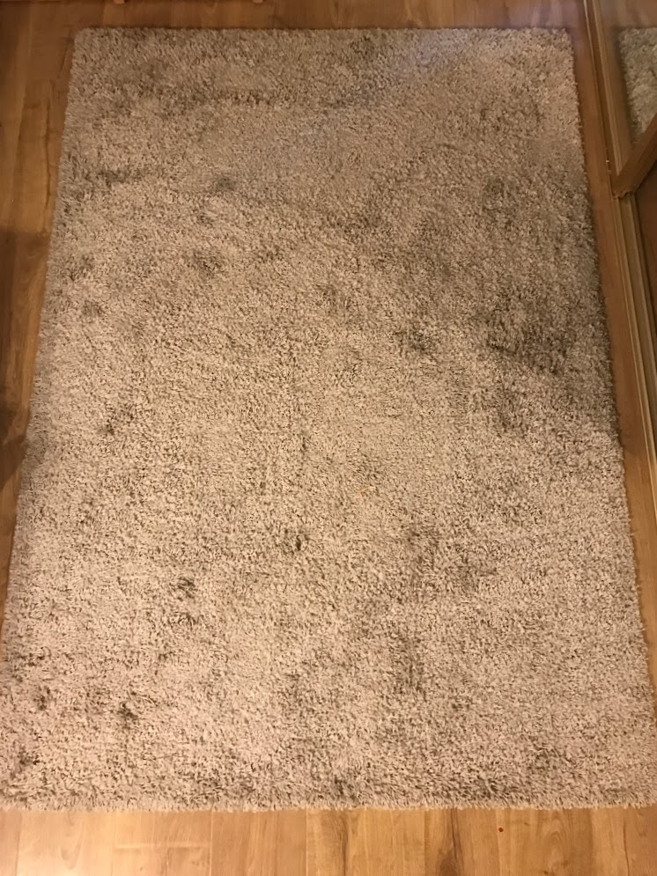
Floor Rug $15
6ft x 4ft

Slide 9
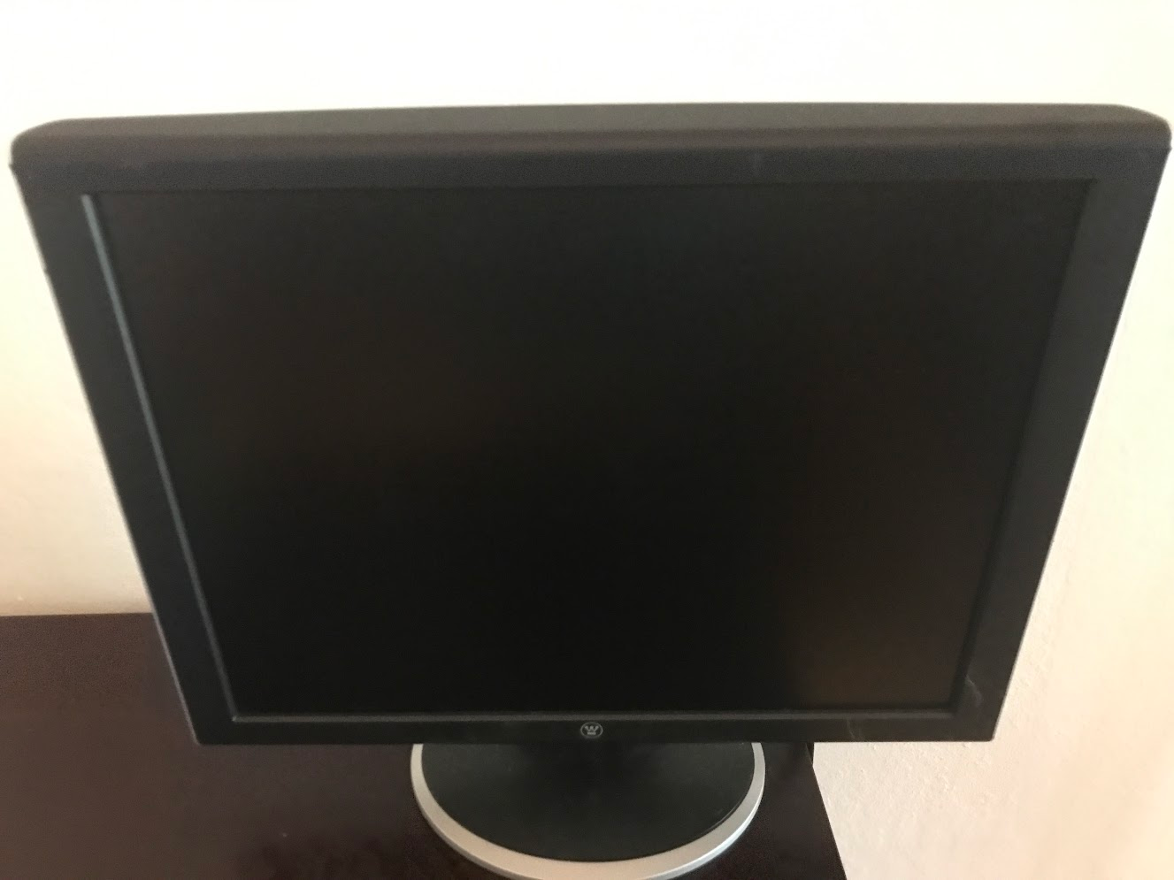
Computer Monitor $5

Slide 10
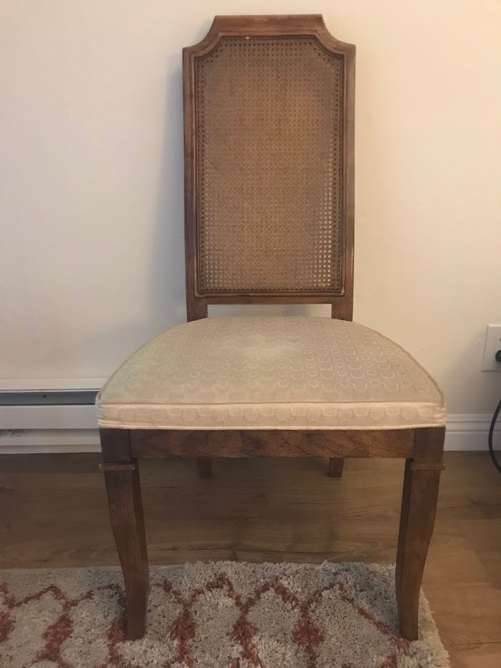
4 Chairs $5 a piece or $15 for set

Slide 11
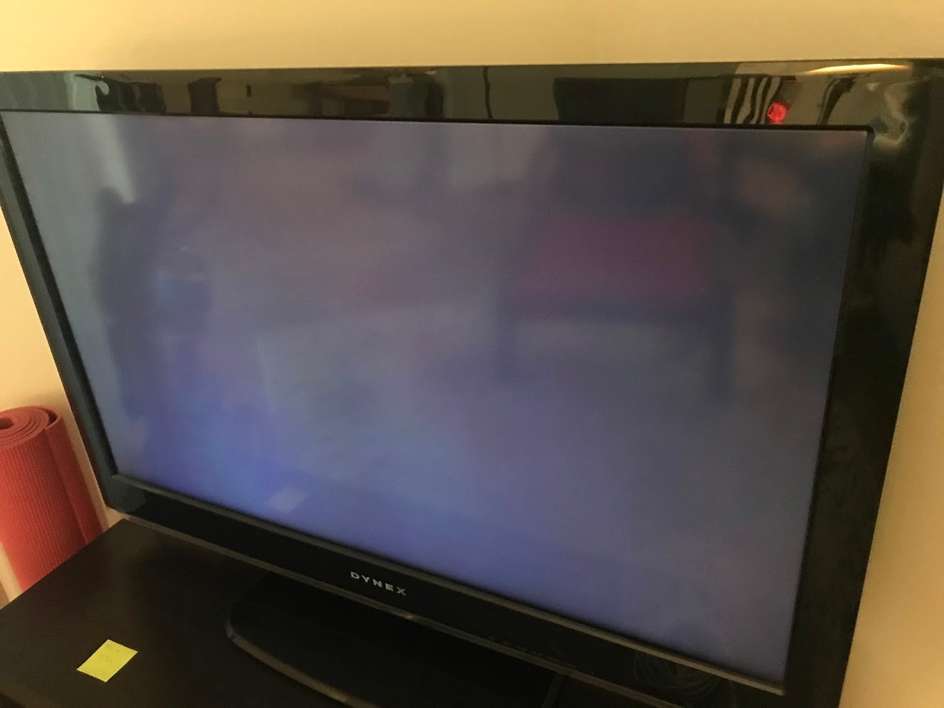
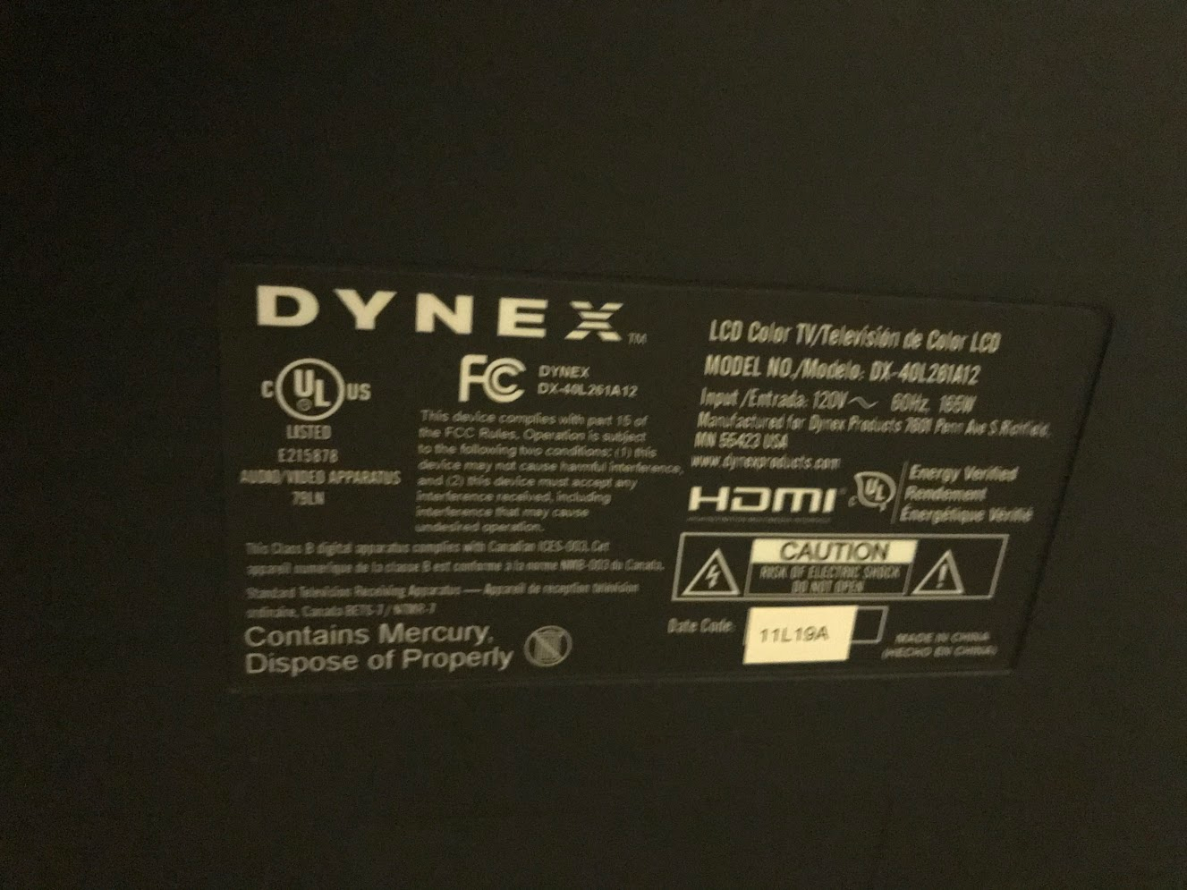
Dynex TV $10
Picture shows up with lines, but they disappear after a while.

Slide 12
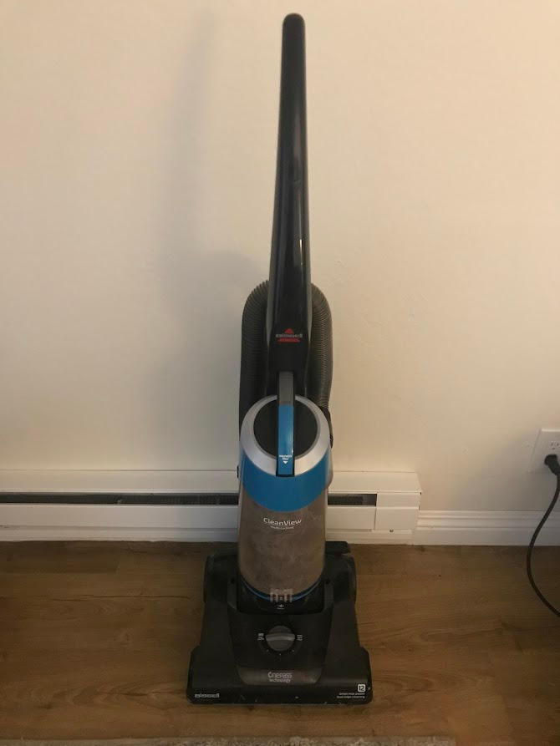
Bissell Vacuum: $25

